Slide 1
GAIL 及其相关

Slide 2
List
Generative Adversarial Imitation Learning GAIL 的提出
Generative Adversarial Self-Imitation learning GASIL
Learning human behaviors from motion capture by adversarial imitation CGAIL
Info GAIL 学习不同示例者背后的隐变量
DIRECTED-INFO GAIL GAIL用VAE做预训练
Model based GAIL 有模型GAIL
Imitation Learning via Kernel Mean Embedding 语义嵌入
Third Person imitation learning 第三视角GAIL
Handsight GAIL handsight gail
Bayesian GAIL 贝叶斯gail
robust-imitation-of-diverse-behaviors GAIL+VAE
VAE-Reinforcement and Imitation Learning for Diverse Visuomotor Skills
TRAJECTORY VAE FOR MULTI-MODAL IMITATION

Slide 4
GAIL
Generative Adversarial Imitation Learning
GAN+IRL
被归类为逆向强化学习中基于概率的方法
分析过程中是基于交叉熵的方法进行分析的

Slide 5
GAIL= >GAN+IRL
C. Generative Adversarial Imitation Learning[1]
directly extracting a policy from data
as if it were obtained by reinforcement learning following inverse reinforcement learning.
之前我们是先通过逆向强化学习，学到一个奖励函数或者代价函数，然后通过R或者C指导强化学习过程，取得新的策略。
现在这里把中间部分融入到GAN中，直接取得策略。
draws an analogy between imitation learning and generative adversarial networks
Notes:
也是基于最大熵的基本理论，套用了GAN 的形式，之所以把它归到这一类中，原因有二，一，它仍然认为我们示例轨迹是最好的，二，它的目标是得到一个能产生于示例轨迹同分布的策略。那么对策略的关注点仍然是统计形式的。具体的统计方法后面会提到。

Slide 6
GAIL= >GAN+IRL
C. Generative Adversarial Imitation Learning[1]()
We characterize the policy given by running reinforcement learning on a cost function learned by maximum causal entropy IRL
Our characterization introduces a framework for directly learning policies from data, by passing any intermediate IRL step
通过对最大熵方法的分析，引出了可以绕过所有IRL步骤，直接从数据中学习策略的方法。
new model-free imitation learning algorithm.
Notes:
也是基于最大熵的基本理论，套用了GAN 的形式

Slide 7
GAIL= >GAN+IRL
直接从数据学策略
在我们的设置中，学习者的占用度量ρπ类似于G生成的数据分布，专家的占用度量ρπE类似于真实的数据分布。
可观测
专家behavior
专家策略
潜在reward
Agent behavior
Agent 策略
目标

Slide 8
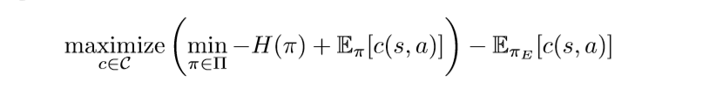
GAIL= >GAN+IRL
C. Generative Adversarial Imitation Learning[1](GAIL= >GAN+IRL)
这里最终目的是从一簇函数中找到一个C，使得在此函数定义之下，最优策略的期望代价，后面那个Eπ，与次优策略的期望代价之差最大，也就是最优策略远远好于次有策略。
Notes:
也是基于最大熵的基本理论，套用了GAN 的形式

Slide 9
GAIL= >GAN+IRL
C. Generative Adversarial Imitation Learning[1](GAIL= >GAN+IRL)
里层的最小化是在c固定的情况下，找到次优策略，这个次优策略要求在所有的候选策略中熵最大，熵最大是最有可能出现，且，代价最小。
Notes:
也是基于最大熵的基本理论，在解释逆向强化学习，只不过是套用了GAN的形式

Slide 10

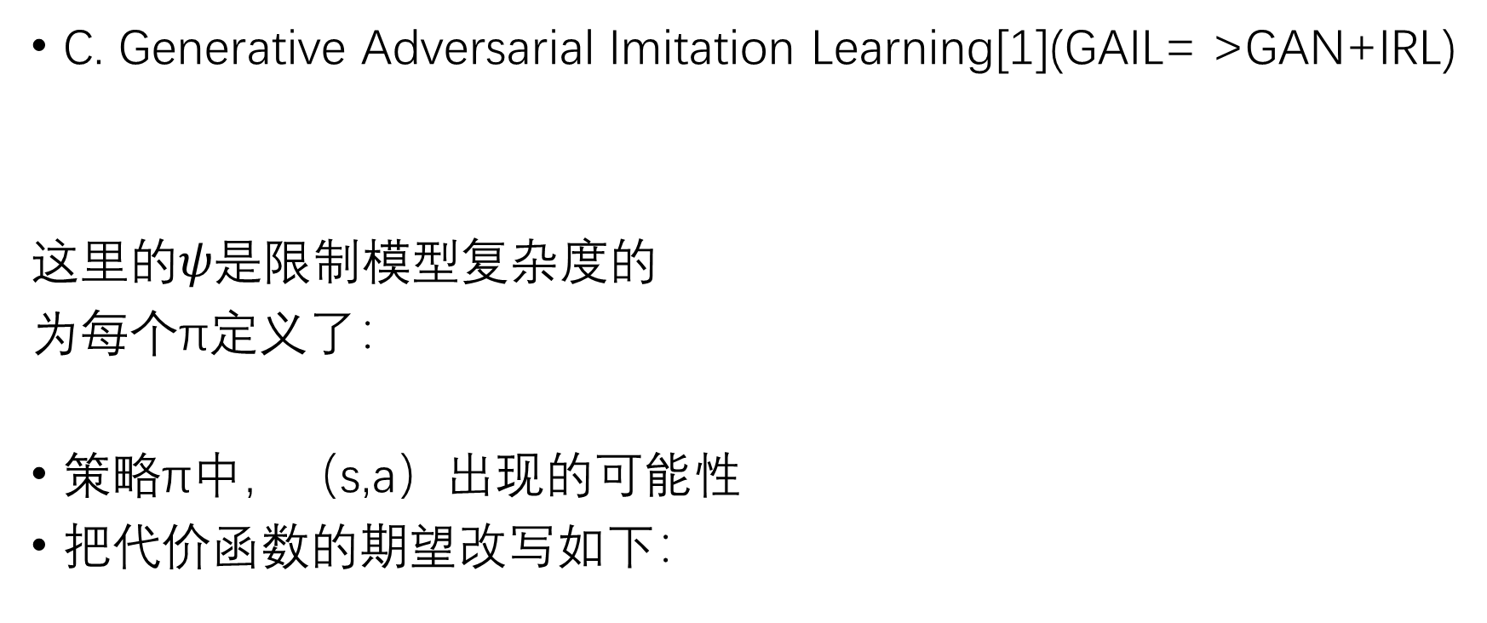
GAIL= >GAN+IRL
C. Generative Adversarial Imitation Learning[1](GAIL= >GAN+IRL)
这里的$ψ是$限制模型复杂度的
为每个π定义了：
策略π中，（s,a）出现的可能性
把代价函数的期望改写如下：
Notes:
也是基于最大熵的基本理论，套用了GAN 的形式

Slide 11
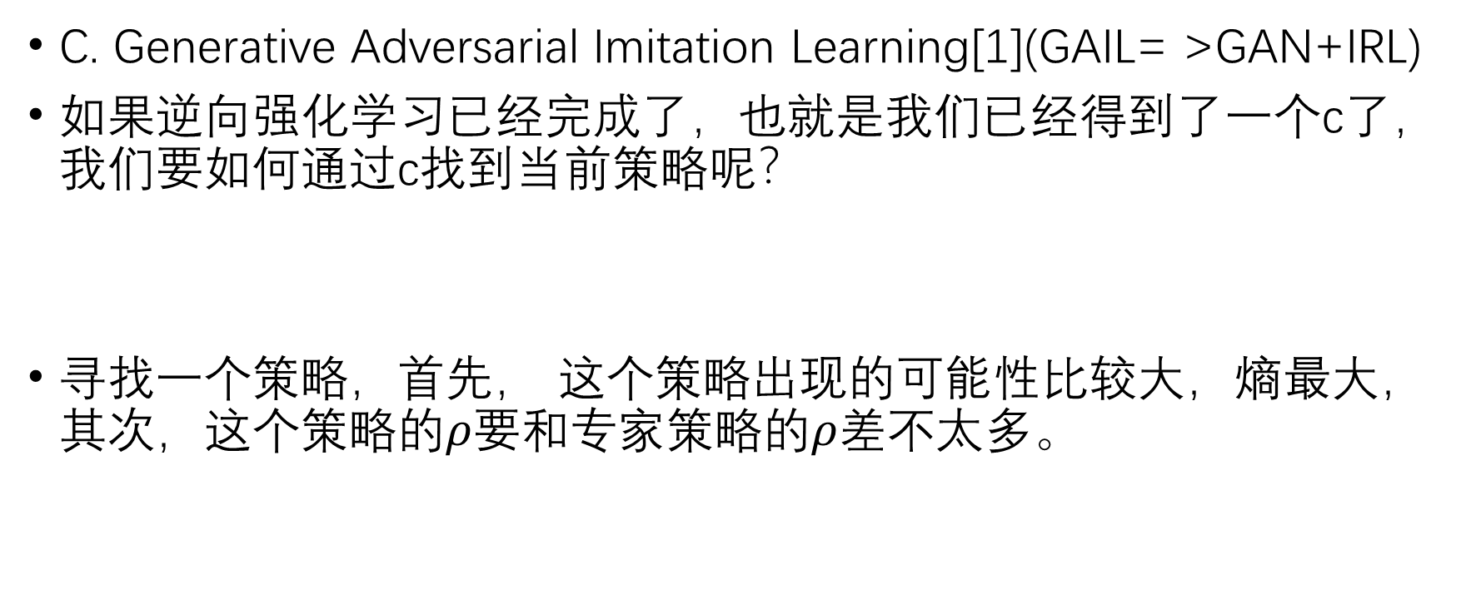
GAIL= >GAN+IRL
C. Generative Adversarial Imitation Learning[1](GAIL= >GAN+IRL)
如果逆向强化学习已经完成了，也就是我们已经得到了一个c了，我们要如何通过c找到当前策略呢？
寻找一个策略，首先， 这个策略出现的可能性比较大，熵最大，其次，这个策略的$ρ要$和专家策略的$ρ差$不太多。
Notes:
也是基于最大熵的基本理论，套用了GAN 的形式

Slide 12
GAIL= >GAN+IRL
First, IRL is a dual of an occupancy measure matching problem, and the recovered cost function is the dual optimum.
Second, the induced optimal policy is the primal optimum.
逆向强化学习与occupancy measure匹配是对偶问题，对偶问题的最优解是损失函数
另外，对偶问题诱导的到的策略exactly是最优策略
Notes:
所以本文的理论思路是先证明occupation 匹配(ocm)与求解损失函数的求优是对偶，然后通过重构ocm, 得到策略。
这里的做法，先证明两个问题对偶，然后在\rho和|\pi 是一一对应的，这样，只要我们找到了对偶问题的最优解，就能得到相应的pi

Slide 13
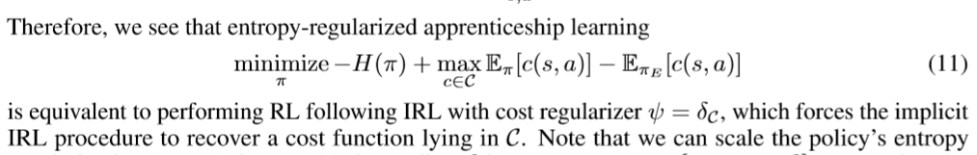
GAIL= >GAN+IRL
4 Practical occupancy measure matching
面临的问题是专家数据过少，无法拟合真正的专家策略
Notes:
文中说：This algorithm relies crucially on the TRPO policy step， 但是没搞明白为啥？

Slide 14


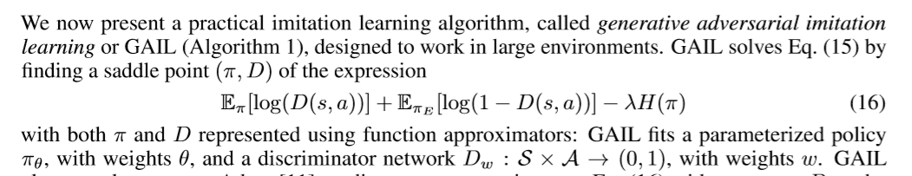
GAIL= >GAN+IRL
在GAIL中
原先公式11的中的正则项
得到：
这个式子draws a connection between imitation learning and generative adversarial networks
Notes:
寻找所谓的鞍点

Slide 15
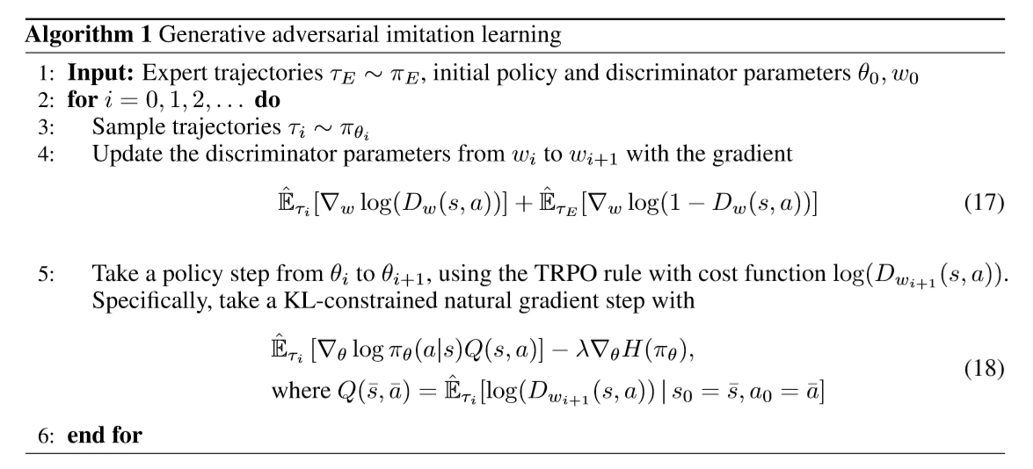
GAIL
C. Generative Adversarial Imitation Learning[1](GAIL= >GAN+IRL)
Notes:
（17）就是GAN判别器的更新方法，（18）就是用TRPO更新生成器，其实这里的生成器就是学习“大师行为”的学生算法，即，最后模仿出来的近似策略。（只是这里的TRPO算法的优化目标变为了对抗判别器的预测结果Dw+1）

Slide 16
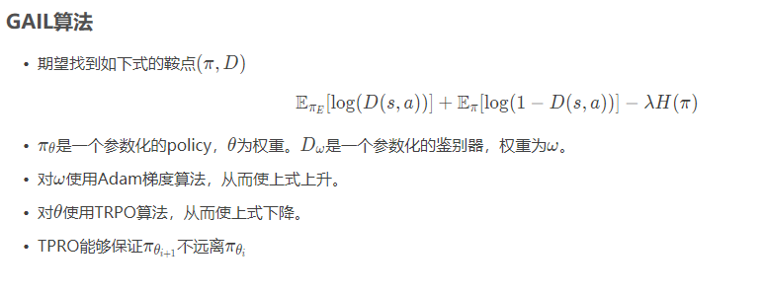
GAIL = >GAN+IRL
C. Generative Adversarial Imitation Learning[1](GAIL= >GAN+IRL)
Notes:
也是基于最大熵的基本理论，套用了GAN 的形式

Slide 17
总结
可以借鉴之处：
文章开篇对应用场景进行限制：We are interested in a specific setting of imitation learning—the problem of learning to perform a task from expert demonstrations—in which the learner is given only samples of trajectories from the expert, is not allowed to query the expert for more data while training, and is not provided a reinforcement signal of any kind. 我们的应用场景可以做一个拓展和改变，在论文中要有体现。
这篇文章的前半部分并没有对GAIL做实质性描述，只是对逆向强化学习中的学徒学习进行一个抽象描述，同时给出了occupancy measure 的合理性
把逆向强化学习的对偶问题类比到GAN的框架中，用gan的生成器生成次优策略，不断逼近最优策略所产生的数据
GAIL中可用的公式都在后半部分了，公式16，要参考一下其它的GAIL扩展是如何处理这一部分内容的。

Slide 19
GASIL
Generative Adversarial Self-Imitation Learning

Slide 20
Abstract
encourages the agent to imitate past good trajectories via generative adversarial imitation learning framework.
Reproduce past good trajectories

Slide 21
Introduction
思路：Instead of directly maximizing rewards, GASIL aims to imitate past good trajectories that the agent has generated using generative adversarial imitation learning framework
优势：
can potentially make long-term temporal credit assignment easier when reward signal is delayed and sparse.
can be interpreted as an optimal reward learning algorithm [24, 25], where the discriminator acts as a learned reward function which provides dense rewards for the agent to reproduce relatively better trajectories
实验是在MUJOCO上与PPO做的比较
Notes:
第二点优势可以借鉴，我们也同样在用判别器的结果作为逆向强化学习的一种loss

Slide 22
Related work
GAN，GAIL， 区别在于， optimal trajectories are not available to the agent in RL，是自己和环境交互产生的
Reward Learning，这里学习了一个判别器D,作为像reward learning 一样的内部奖励函数。
Self-imitation， retreiving similar states in the past and choosing the best action made in the past.相反，我们的GASIL直接学习模仿过去的好轨迹，而不学习生成模型。GASIL可以看作是自我模仿学习[19]的生成式对抗性扩展，它更新了策略和价值函数，使其朝着过去更好的方向发展。
Notes:
待查 More recently, Goyal et al. [8] proposed to learn a generative model of preceding states of high-value states (i.e., top-K% trajectories) and update a policy to follow the generated trajectories.
竟然可以这样写： Contemporaneously with our work, Gangwani et al. [6] also proposed the same method as our GASIL, which was independently developed.
【6】learning self-imitation diverse policies

Slide 23
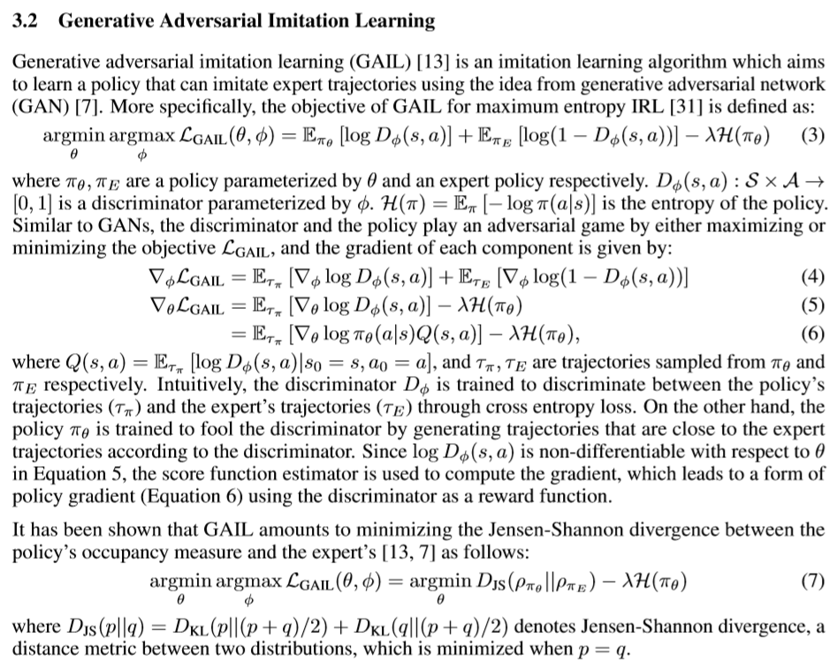
Background
包括对动作状态的定义，对occupancy measure 的定义
对策略梯度法的定义
对GAIL的定义

Slide 24
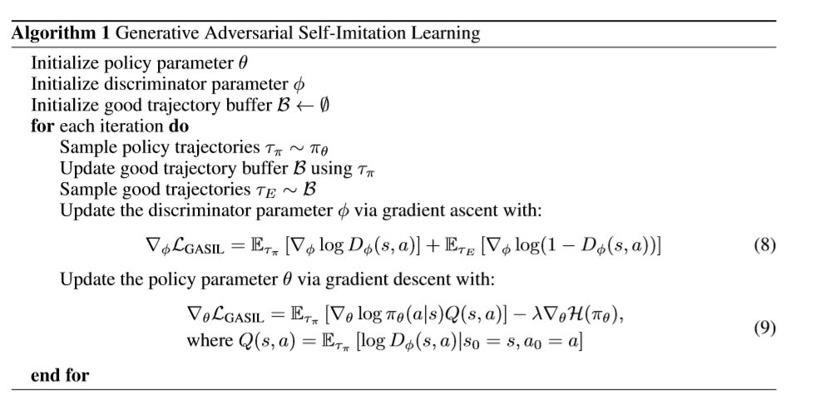
Generative Adversarial Self-Imitation Learning
在正场当中并没有给出太多的公式，只给出了算法流程
Notes:
这里主要强调对trj buffer 的更新

Slide 25
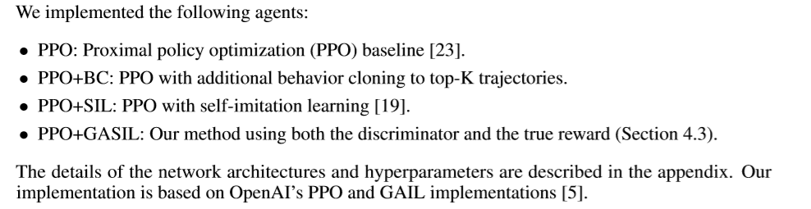
Experiments
Notes:
这种写作方法值得借鉴

Slide 26
总结
可借鉴的地方：其实这篇文章也同样没有什么新的理论支撑，只是在gail中把专家数据换成了对好的轨迹的存储，然后再拿出来做模仿。但是仍然可以成文，不知道是否录用。
文中对实验的分析占据了大部分篇幅，要好好学学
在background 中把几个相关算法的公式列出来了，然后在自己的算法介绍部分只给出流程图，然后给出公式的补充

Slide 29
CGAIL
Learning human behaviors from motion capture by adversarial imitation

Slide 30
Abatract
针对之前的模仿学习和监督学习只能完成刻板的固定动作，这里对生成对抗学习（GAIL）做拓展，从只有部分观测的有限示例中，产生humanlike 行为模式。
我们利用这种方法从运动捕捉数据构建子技能策略，并表明当由更高级别的控制器控制时，可以重用它们来解决任务。

Slide 31
Introduction
从童话故事写起
然后说我们只能产生特定的动作，而且大部分通过奖励函数设计完成
给出的方案是：use motion capture data as demonstrations to load movements into controllers。当然文中也给出了几个缺陷，为了克服这些难点，出现了GAIL , 这里对GAIL的评价是：the notion of similarity between imitation and demonstration data does not have to be deﬁned based on an explicit, hand-designed metric（我们不再需要显式度量两组数据）
本文的特点：1. training low-level controllers to produce behaviors from motion capture using an extension of GAIL
2. embedding the low-level controllers into larger control systems wherein a high-level controller learns by RL to modulate the low-level controller to solve new tasks
We demonstrate:
(a) partial state featurizations without demonstrator actions sufﬁce for adversarial imitation;
(b) the body structure and physical parameters (i.e. body dynamics) need not match between the demonstrator and the imitator; and
(c) robust transitions between behaviors naturally emerge by training on multiple behaviors.
Notes:
在做一种分层的学习，但是并不是很清晰底层（low-level）和上层（high level ）之间的关系

Slide 32
Method
Gail :we demonstrate that adversarial imitation learning can work even when the discriminator only has access to states (not actions) as well as partial state observations.
Each iteration consists of three essential steps: (1) collect data using the current policy; (2) update the policy using rewards determined by the discriminator; (3) update the discriminator using the demonstration data and generated data.
TRPO在这里的作用

Slide 33
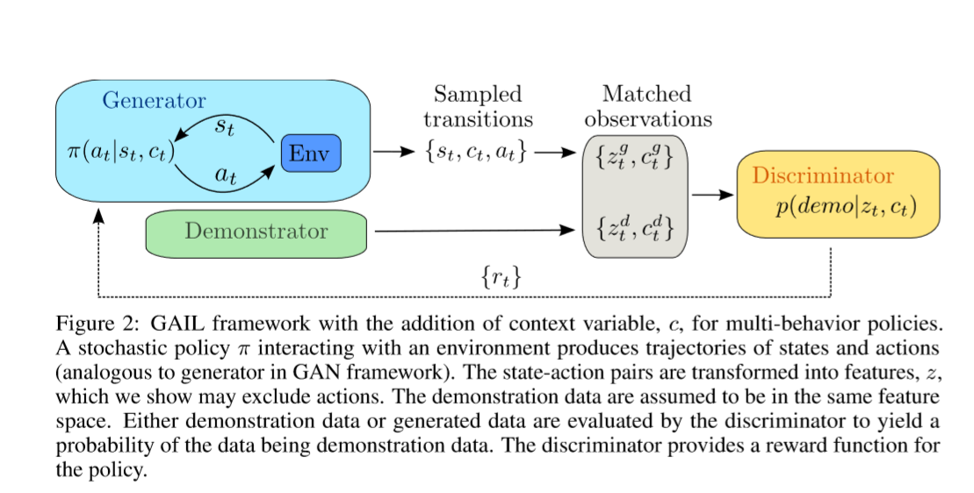
文中的经典流程图
Notes:
参考图示来源：Learning human behaviors from motion capture by adversarial imitation

Slide 34
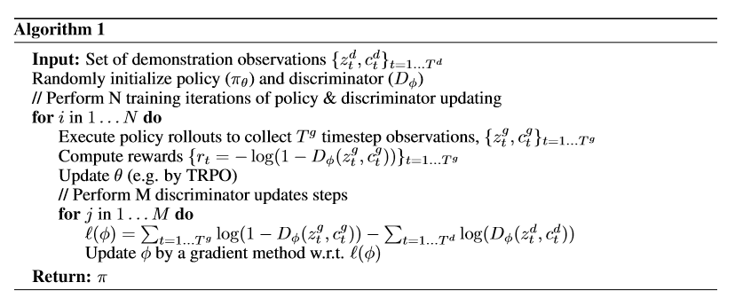
算法流程图
Notes:
要搞清楚其中的C到底有何用途？

Slide 35
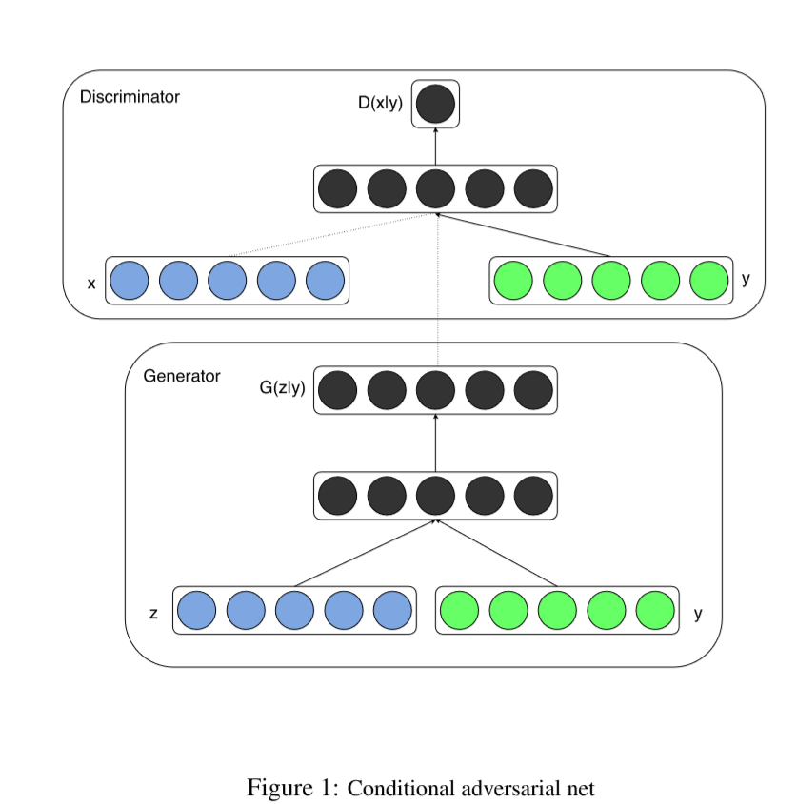
相关理论之Conditional GAN
Conditional GAN
We show that this model can generate MNIST digits conditioned on class labels.
Conditional GAN 主要内容是:
其中的y 任意

Slide 36
总结
可借鉴之处：
文中开篇提到奖励函数的手工设计问题，我们是否也有解决方案，不进行奖励函数的设计，直接求取它呢？
疑问：算法中竟然只字未提c是啥，可以看看代码中有木有
在CGAN中的C可以任意，我们现在的想法是能不能将当前状态或者环境信息抽象之后引入到GAIL中去形成CGAIL的一种特殊问题

Slide 38
Info GAIL
InfoGAIL:InterpretableImitationLearningfrom VisualDemonstrations
学习不同示例者背后的隐变量

Slide 39
abstract
学习不同专家得到的示例背后的一些潜在因素
The goal of this paper is to develop an imitation learning framework that is able to automatically discover and disentangle the latent factors of variation underlying expert demonstrations.
Our method, built on top of Generative Adversarial Imitation Learning, can not only imitate complex behaviors, but also learn interpretable and meaningful representations of complex behavioral data, including visual demonstrations.

Slide 40
Introduction
从奖励函数不好构造入手，说模仿学习的重要性，然后引入GAIL，而在GAIL中面临的一个问题就是提供示例的专家并非一个，那么他们的策略所产生的数据就会有偏重，普通的GAIL是无法建模这个问题的，所以
The goal of this paper is to develop an imitation learning framework that is able to automatically discover and disentangle the latent factors of variation underlying expert demonstrations。 We propose a new method for learning a latent variable generative model that can produce trajectories in a dynamic environment
Our approach is an extension of GAIL, where the objective is augmented with a mutual information term between the latent variables and the observed state-action pairs.

Slide 41
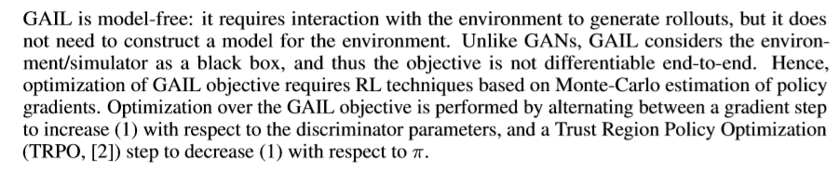
Background
Preliminaries
Imitation learning： The goal of imitation learning is to learn how to perform a task directly from expert demonstrations, without any access to the reinforcement signal r.
Generative Adversarial Imitation Learning：
通过衡量s-a对分布的相似性衡量 策略的相似性

Slide 42
Interpretable Imitation Learning through Visual Inputs
In this section, we propose an approach that can
1)discover and disentangle salient latent factors of variation underlying expert demonstrations without supervision,
2)learn policies that produce trajectories which correspond to these latent factors, and
3) use visual inputs as the only external perceptual information.
这里会有一个待估计的隐含变量c用于指导不同的策略的生成。
这里引入了互信息的最大化
在优化D的同时要优化Q

Slide 43
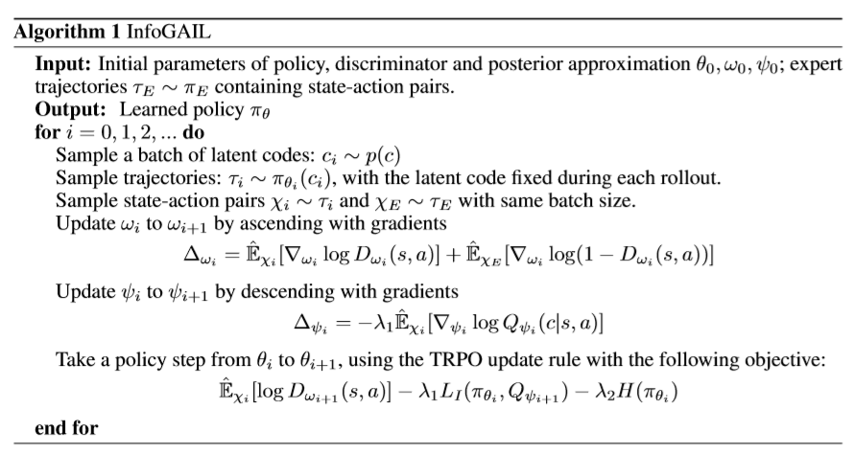

Slide 44
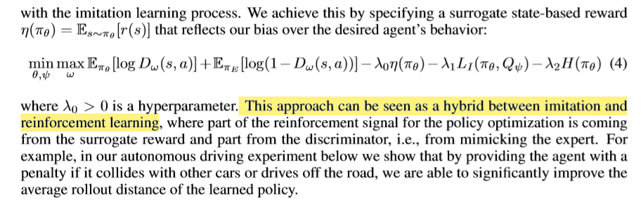
infogail
提供了一种将reward 引入判别器D 的方法：

Slide 45
Experiments
. By conducting experiments on these two environments, we show that our learned policy can
1) imitate expert behaviors using high-dimensional inputs with only a small number of expert demonstrations,
2)cluster expert behaviors into different and semantically meaningful categories , and
3) reproduce different categories of behaviors by setting the high-level latent variables appropriately.

Slide 46
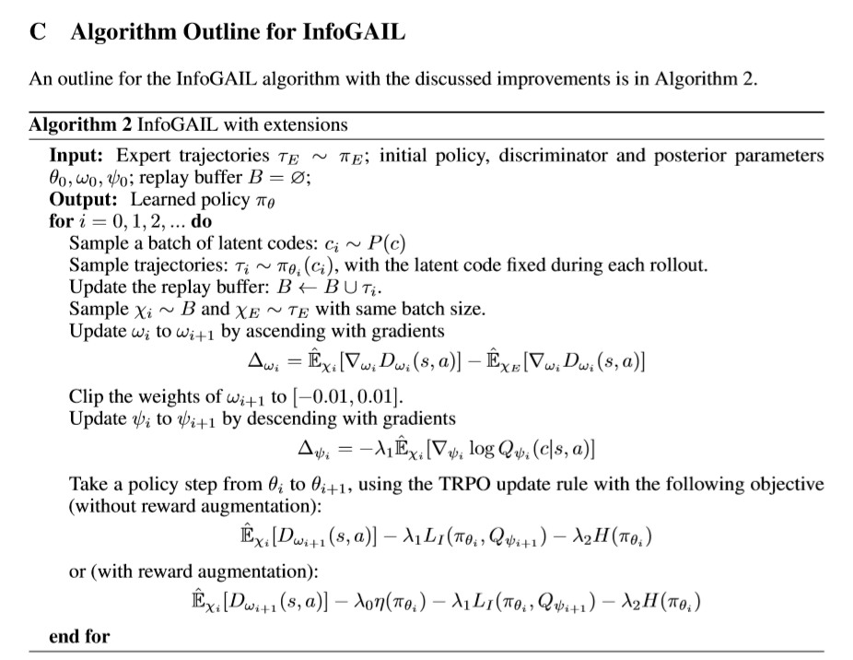

Slide 47
相关理论之info-GAN
Info-GAN
Info GAN 讲了以下几个问题：
This concept was introduced by InfoGAN [14], where latent codes are utilized to discover the salient semantic features of the data distribution and guide the generating process. （待续）

Slide 48
总结：
可借鉴之处
这篇文章从GAIL入手把问题的环境限制在一个多专家示例的条件下，然后提出了利用示例轨迹和隐含变量的互信息来区别不同的专家信息。
行文安排上，是在background 部分把模仿学习，GAIL的理论信息直接挪用，然后在自己的算法介绍中直接写入补充部分，给出算法伪代码
这里值得注意的是对reward augmentation 的引入方式，可以借鉴到我们的行文中，他不是把现实信息加入生成器，而是把现实信息加入到判别器中去。

Slide 50
D-info GAIL
DIRECTED-INFO GAIL: LEARNING HIERARCHICAL POLICIES FROM UNSEGMENTED DEMONSTRATIONS USING DIRECTED INFORMATION
GAIL用VAE做预训练，学习一些任务的子任务和子策略

Slide 51
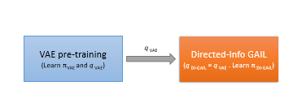
Abstract
在这项工作中，我们使用一个有向图形模型，从子任务的状态动作轨迹序列中发现它们之间的相互作用。提出了一种基于生成式对抗性模仿学习框架的新算法，该算法能从未分割的示例中自动学习子任务策略。
We also show how our approach connects with the existing Options framework, which is commonly used to learn hierarchical policies.
Notes:
代码未能实现，与options framework的联系，以及与分层策略的联系 有待深究

Slide 52
Introduction
In summary, the main contributions of our work include:
• We extend existing generative adversarial imitation learning frameworks to allow for learning of sub-task speciﬁc policies by maximizing directed information in a causal graph of subactivity latent variables and observed trajectory variables.
• We draw connections between previous works on imitation learning with sub-task policies using options and show that our proposed approach can also be seen as option learning in a generative adversarial setting.
• We show through experiments on both discrete and continuous state-action spaces, the ability of our approach to segment expert demonstrations into meaningful sub-tasks and combine sub-task speciﬁc policies to perform the desired task.

Slide 53
Related
Imitation learning
Options :find bottleneck states，index by options, After an option is initiated, actions are generated by the sub-policy until the option is terminated and a new option is selected.
Prior work in robot learning has also looked at learning motion primitives from unsegmented demonstrations.
Notes:
Niekum&Barto(2011)usedtheBeta-ProcessAutoregressiveHiddenMarkovModel(BP-AR-HMM) to segment expert demonstrations and post-process these segments to learn motion primitives which provide the ability to use reinforcement learning for policy improvement.

Slide 54
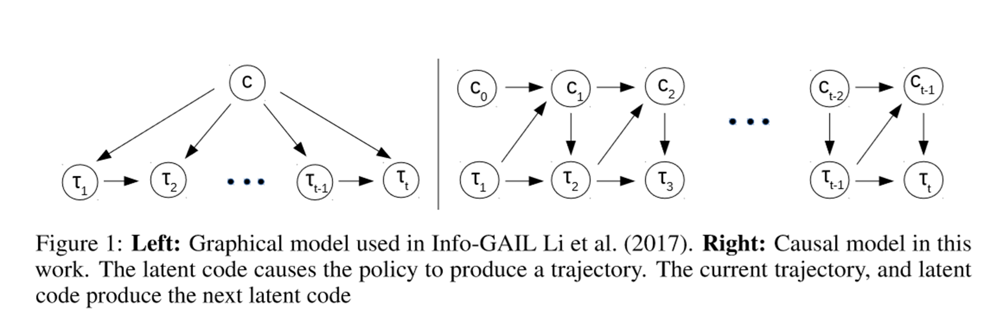
Proposed approach
之前的info gail用一个隐变量来刻画子任务
而D-infoGAIL 则希望用一个有向图结构来刻画各个子任务之间的关系

Slide 55
Proposed approach
为了强制模型使用这个潜在变量，这些方法提出了最大化状态-操作对的演示序列与子活动潜在嵌入变量之间的互信息
然后又把最大化互信息转换为对其下届的一个约束
现在我们用有向信息取代互信息
we can replace the dependence on τ with a dependence on the trajectory generated up to current time t.
同样引入一个真实后验分布的下届

Slide 56
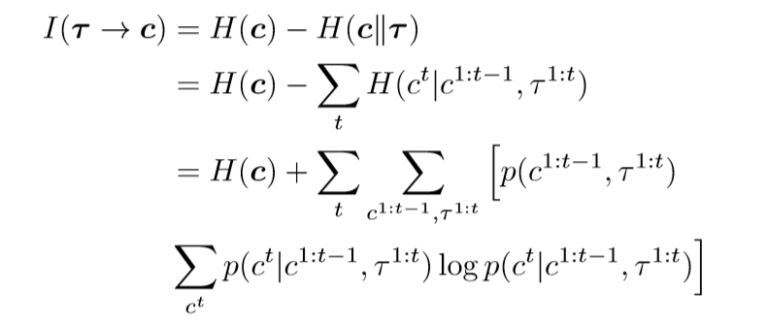
Proposed approach
基于有向图的概率分布
引入下界之后

Slide 57
Proposed approach
将有向信息构成的loss 引入到我们的GAN中
得到
这要求我们要从p(c)当中去采样，所以要事先得到
In order to estimate this distribution, we ﬁrst pre-train a variational auto-encoder (VAE) on the expert trajectories

Slide 58
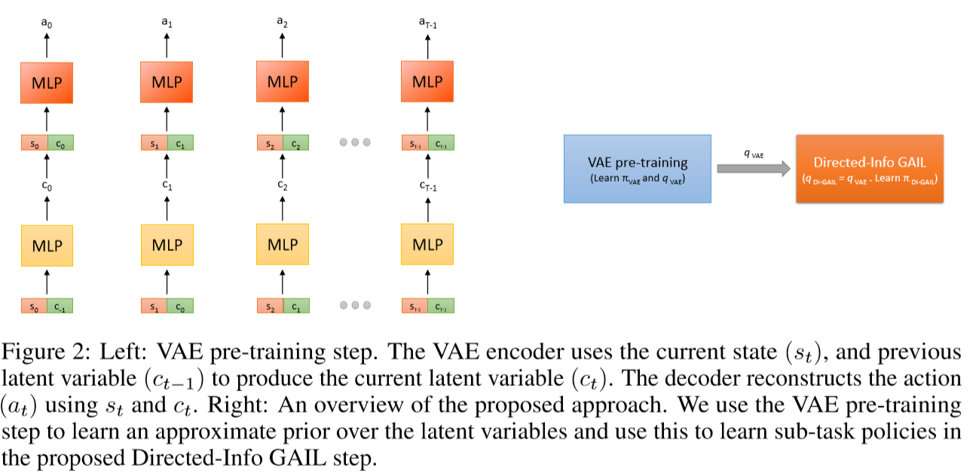
Pretrain vae
编码器和解码器均使用的是多层感知机
s(t)+c(t-1) =>encoder=>c(t) +s(t) =>decoder=>a(t)
Notes:
We used the Gumbel-softmax trick (Jang et al., 2016) to obtain samples of latent variables from a categorical distribution(查)

Slide 59
connection with options framework
在option framework中把termination 和 option latent variables分开，而我们这里把它们合成一个隐变量了
Our proposed Directed-Info GAIL can be therefore be considered as the generative adversarial variant of imitation learning using the options framework

Slide 60
Experiment
(1) our method is able to segment out sub-tasks from given expert trajectories,
(2) learn sub-task conditioned policies, and
(3) learn to combine these sub-task policies in order to achieve the task objective.
代码中的数据是以轨迹形式存储的，这一点与我们之前的DQFD是不同的，而且实现过程中使用的是GRU，是一种循环网络结构
Notes:
深刻感觉自己的基础知识需要补充

Slide 61
总结
可借鉴之处

Slide 63
Model based GAIL
Model-based Adversarial Imitation Learning
Notes:
主要想搞清楚，到底什么样的情况会被定义为有模型的情况

Slide 64
Abstract
However, a model-free approach does not allow the system to be differentiable, which requires the use of high-variance gradient estimations.
We show how to use a forward model to make the system fully differentiable, which enables us to train policies using the (stochastic) gradient of D.
our approach requires relatively few environment interactions,
fewer hyper-parameters to tune
Notes:
原来model free是不可微分的根源

Slide 65
Introduction
目标：专家轨迹已知，回报函数未知，从示例中模仿专家策略。
关于 behavior clone
关于 IRL
关于GAN
无模型方法的缺点：
不能进行误差反传，
High variance gradient estimations
在有模型的方法中，策略梯度可以通过判别器的误差梯度直接得到，是一个端到端的模型

Slide 66
Back ground
马尔可夫过程
模仿学习
生成对抗模型
We claim that the reason is that the REINFORCE gradient discards the Jacobian matrix of the graph part down stream the stochastic unit.
In the following we show how by including a forward model of the environment, the system can be differentiable end-to-end, allowing us to use the partial derivatives of D : [∇aD,∇sD] when differentiating Eq. 3 with respect to θ.
Notes:
GAIL的目标是完成对专家数据统计规律的模仿，并不是结构信息，只是s-a tuples
GAIL draws a similar objective function like GAN, except that now pE stands for the expert’s joint distribution over state-action tuples

Slide 67
Background
Model free 的一个问题是不可导，无法进行误差反传。不可导的原因是，策略函数能够根据从状态给出动作，但是动作作用于一个未知的环境，才能产生下一个动作，但这个过程是未知的，通过采样得到，根本没有一个可导的函数来表示如何由动作得到下一个状态。
已有的解决方案是：REINFORCE 1992中， A common solution is to use the likelihood-ratio estimator
虽然无偏unbiased，但是会有高方差high variance
另外一个不足之处是，这种需要大量的与环境进行交互

Slide 68
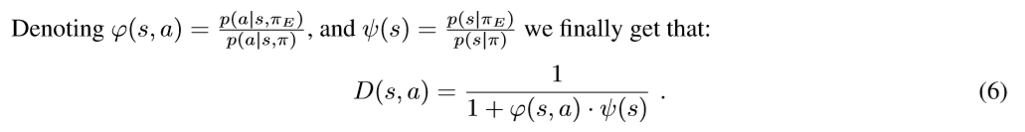
Algorithm
一个是策略似然的比例，一个是状态似然的比例
”How likely is state s under the distribution induced by πE vs. the one induces by π?
”How likely is action a given state s, under πE vs. π?”.

Slide 69
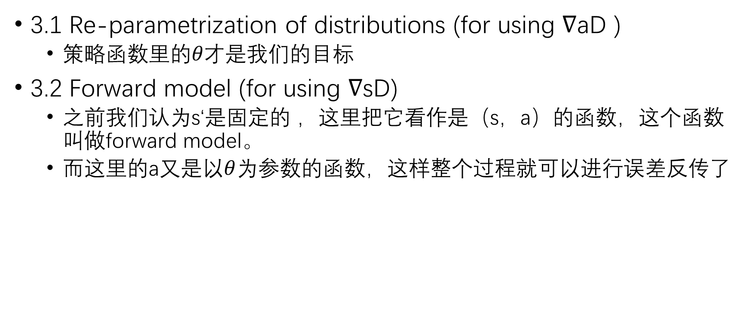
Algorithm
3.1 Re-parametrization of distributions (for using ∇aD )
策略函数里的$θ才是$我们的目标
3.2 Forward model (for using ∇sD)
之前我们认为s‘是固定的 ，这里把它看作是（s，a）的函数，这个函数叫做forward model。
而这里的a又是以$θ$为参数的函数，这样整个过程就可以进行误差反传了

Slide 70

MAIL Algorithm
a) to use a model, and（一要有模型）
b) to process multistep transitions instead of individual state-action pairs.（二要有轨迹）
之前是在s-a对上定义奖励函数，r(s,a) = −D(s,a). 现在要在一个trajectory 上定义奖励

Slide 71
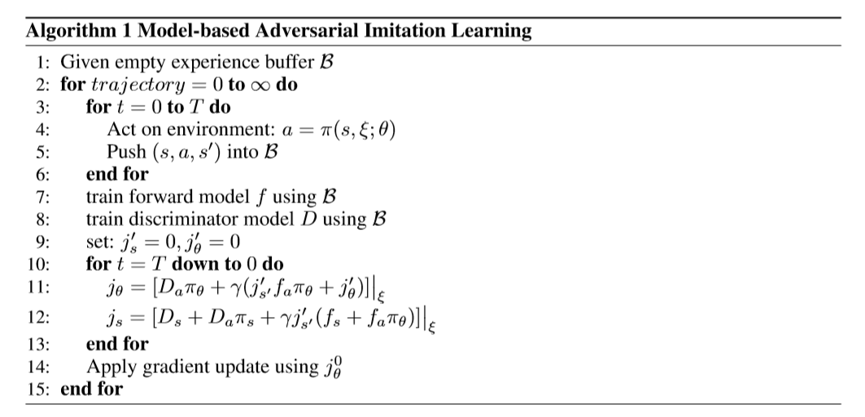
Notes:
这里面train 了两个两个model, 一个是模型的，一个是判别器的，那么策略的呢？

Slide 72
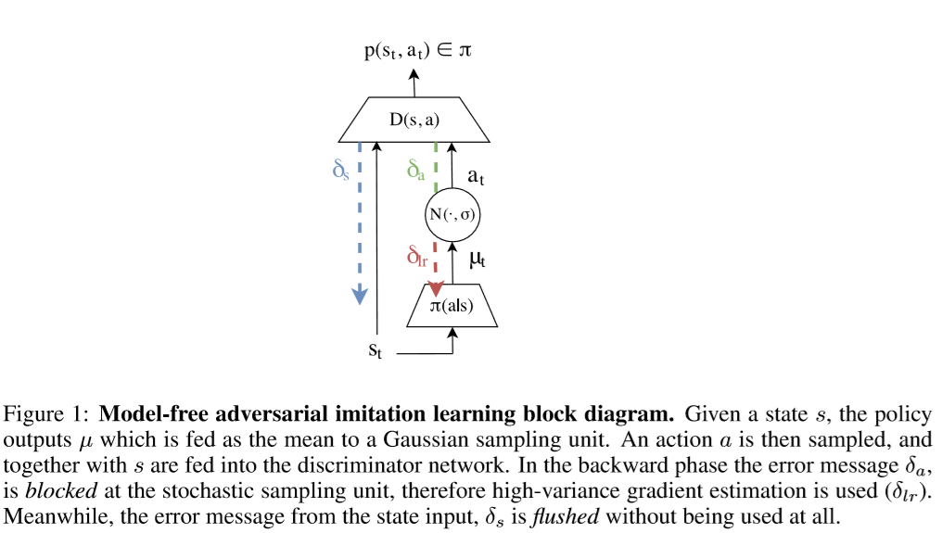
无模型
Notes:
The model-free approach treats the states as ﬁxed and only tries to optimize the behavior

Slide 73
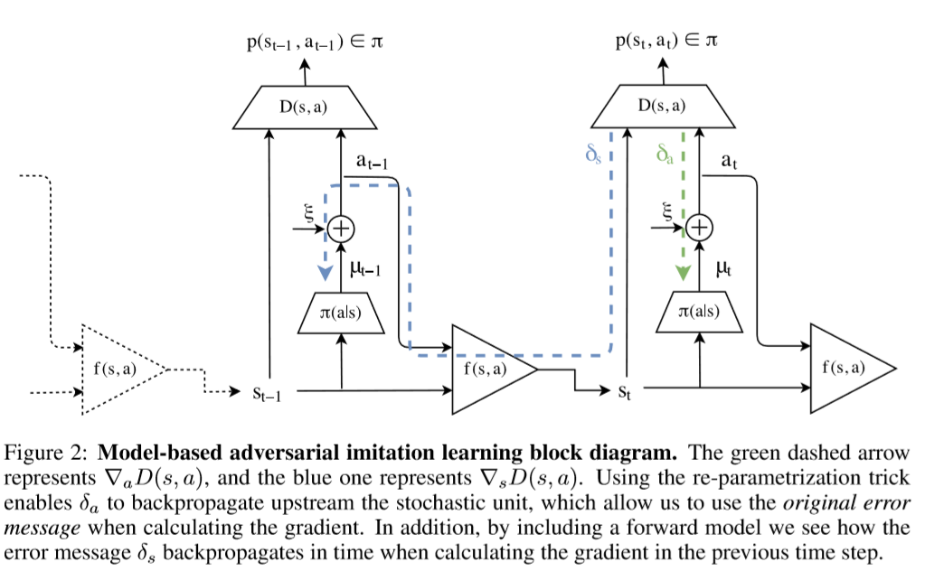
有模型
Notes:
Therefore, instead of viewing it as ﬁxed, we suggest expressing s as a function of the policy by setting: s0 = f(s,a),where f is the forward model.
那么问题来了，这个f是怎么弄出来的呢？难道也是一次一次迭代来的？相当于我们不仅训练了一个策略模型，还训练了一个环境模型？

Slide 74
总结
The accuracy of the forward model is crucial when backpropagating gradients recursively in time. An inaccurate model will lead to noisy gradients and will impede convergence
Notes:
如何准确地进行环境建模，或者说我们是不是可以

Slide 76
Imitation Learning via Kernel Mean Embedding
Imitation Learning via Kernel Mean Embedding

Slide 77
abstract
利用生成的逆向学习网络(GANs)进行模仿学习，但我们减少到分布式学习的过程要简单得多，具有强大的专家论证能力，且样本效率高。

Slide 78
总结

Slide 80
Third-Person Imitation learning
THIRD-PERSON IMITATION LEARNING

Slide 81
Abstract
they observe other humans perform tasks, infer the task, and accomplish the same task themselves.

Slide 82
总结

Slide 84
Hindsight GAIL
Hindsight Generative Adversarial Imitation Learning

Slide 85
Abstract
We propose Hindsight Generative Adversarial Imitation Learning(HGAIL) algorithm, with the aim of achieving imitation learning satisfying no need of demonstrations.
Notes:
目标是在没有示例的情况下完成模仿学习

Slide 86
Introduction
we propose hindsight generative adversarial imitation learning (HGAIL) algorithm, which combines the idea of hindsight inspired from psychology [14] and hindsight experience replay (HER) [15] with GAIL into a uniﬁed learning framework
1. Expert-like samples are converted from rolled-out trajectories based on hindsight transformation, where the rolled-out trajectories are directly treated as negative samples without any change, which satisﬁes the requirements for training the discriminator and the generator.
2. our HGAIL algorithm essentially endows curriculum learning mechanism in the adversarial learning procedure.
our main contribution is a method of achieving imitation learning with no demonstration data available.
Notes:
Hindsight is not equal to foresight: The effect of outcome knowledge on judgment under uncertainty[J].
Hindsight experience replay
主要目标：没有示例的情况下实现模仿学习
基于后验变换，专家样本由外推轨迹转换而来，内推轨迹直接作为负样本处理，不作任何改变，满足了对判别器和生成器进行训练的要求。

Slide 87
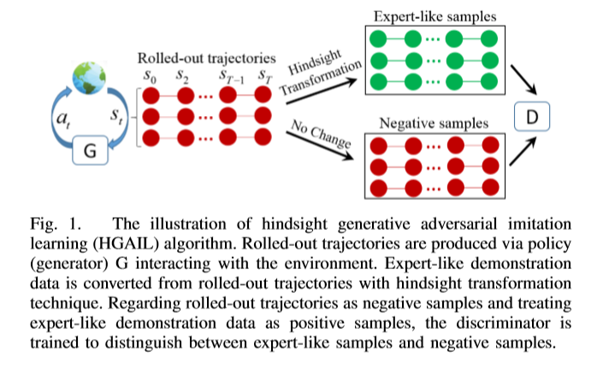

Slide 88
Related work
1Imitation Learning
2Hindsight Experience Replay
针对稀疏奖励提出
在没有奖励的时候也要找到过程中的某个状态作为临时目标
3 Learning with Few Data
meta-learning framework
neural task programming
combining reinforcement with imitation learning
Zero-shot learning
self-imitation learning methods
Generative Adversarial Self-imitation Learning (GASIL) method,
Notes:
还有这么多learning with few data的方法
本文是利用hindsight 的方法直接将生成数据转换成专家数据

Slide 89
METHOD
先说GAIL : 生成器生成轨迹，判别器判断从生成轨迹和专家轨迹中采样得到的s-a对.
At the beginning, agent从G中采样一个目标g, 初始化状态s,
t时刻， 从正态分布中采样动作at, 正态分布的均值是策略网络的输出，at ∼ N(πθ(st||g),δ)
作用于环境之后产生下一个状态和相应的reward，这个reward是由判别器给出的。
At the end, generate n条rolled-out 轨迹
接下来要把这些rolled-out 轨迹转换成专家轨迹
Notes:
GAIL判别的是S-A对，不是轨迹

Slide 90
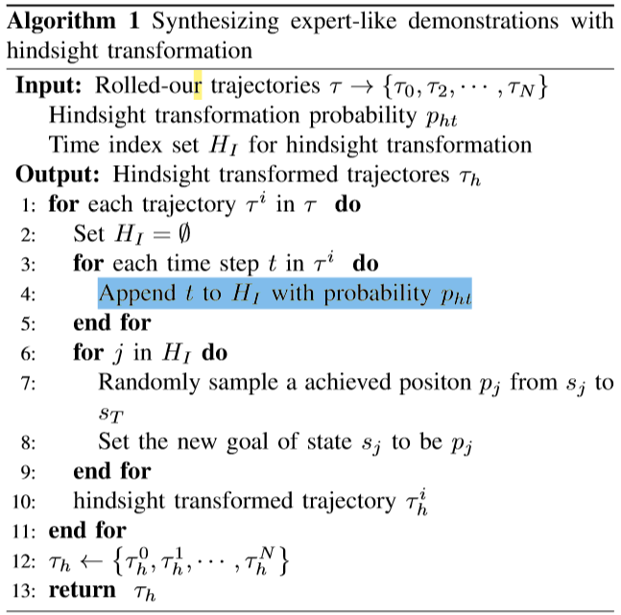
METHOD
Notes:
随机地从后面状态中抽取一个作为目标进行迭代，生成器用的是ppo

Slide 91
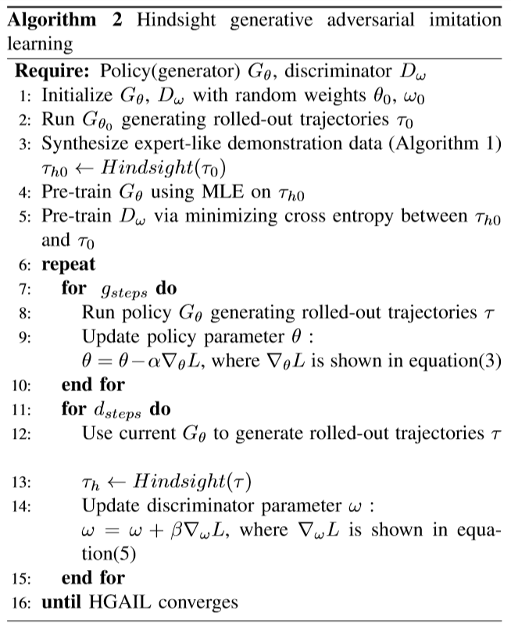
HGAIL
Notes:
我们把没有经过筛选的作为负样本，把筛选之后的作为正样本

Slide 93
总结

Slide 95
Bayesian GAIL
A Bayesian Approach to Generative Adversarial Imitation Learning

Slide 96
Abstract
We ﬁrst propose a Bayesian formulation of generative adversarial imitation learning (GAIL), where the imitation policy and the cost function are represented as stochastic neural networks. Then, we show that we can signiﬁcantly enhance the sample efﬁciency of GAIL leveraging the predictive density of the cost, on an extensive set of imitation learning tasks with high-dimensional states and actions.

Slide 98
Gail+vae
VAE+IRL-robust-imitation-of-diverse-behaviors

